Slide 1
Hanoi Media Lab Project Hanoi University/The New School

Slide 2
Hanoi University

Slide 3
Media Studies Video Equipment Arrives in Hanoi - August 2007

Slide 4
Mr. Quang and Mr. Minh deliver cameras and computers to The Media Lab

Slide 5
from Theory to Practice

Slide 6
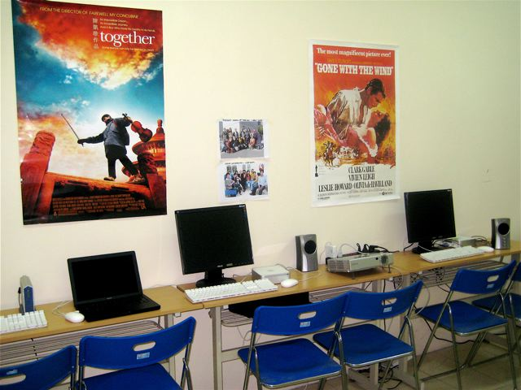
The HANU Media Lab

Slide 7
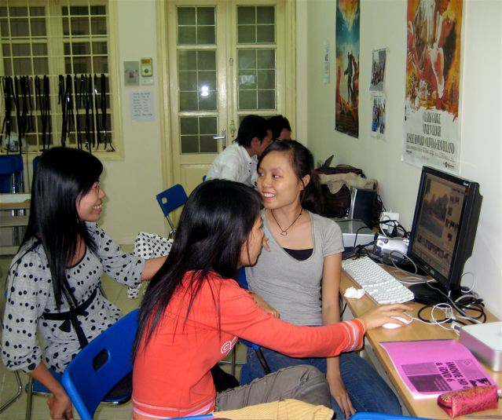

Slide 8
Fall 2007 Visit from Prof. Hank McGuckin

Slide 9
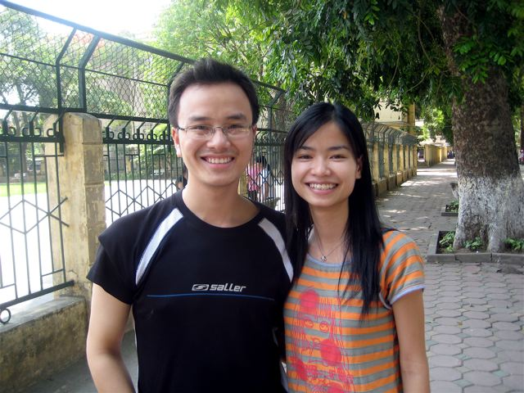
Film Class Assistant Nam

Slide 10
Lab Assistant Ha with Tuyen

Slide 11
Dinner with UC Prof. Cary Trexler, HANU President Vang, Assistant Thu Huong, Deputy Minister Hung, & Fulbright Director Dr. Thao

Slide 12
Documentary Film Class
Documentary Film Production for International Studies
April - June 2008
Hanoi University
Carol Wilder Douglas Jardine
carolwildernyc@gmail.com dougjardine76@gmail.com
Lab Technician: Pham Viet Ha
phamvietha26585@gmail.com
7:30-11:15 am Wednesday
HANU Media Lab: Building A - Room 308
This ten week course is designed to teach you how to write, shoot, and edit a short digital documentary video related to your International Studies curriculum. Concepts covered will include writing and planning the production, introduction to the camera and photography fundamentals, directing and shooting the project, basic concepts in editing, and methods for distribution. Students will work in small crews of 3-4 to create a documentary film about a topic related to their studies. This will result in a 10 minute documentary video from each group. The course will also cover an introduction to film and documentary history as well as key concepts in film studies.

Slide 13
Documentary Film Production for International Studies
Course Schedule – Spring 2008
(Classes meet every Wednesday a.m. with additional lab and field time.)
02 April Overview of Digital Documentary Filmmaking
Read Carlson Chapters 1-3.
In class: Hands on Lesson in How to Plan, Shoot, Edit, and Burn to DVD
09 April Filmmaking History and Concepts (Lecture)
Read Roberts-Breslin Chapters 2-3
In Class: Exercises in Finding a Subject, Writing a Synopsis, and Preproduction Planning
16 April Introduction to Camera and Lighting
Read Roberts-Breslin Chapter 6
Read Carlson 4-5 (Quiz)
In Class: Hands on Camera Exercises in
Lighting, Composition, and Camera Movement

Slide 14
Doc Film Production Schedule continued
23 April Shooting your Video 1
Work in Crews On Site
30 April Shooting your Video 2
Midterm Vocabulary Test
07 May Editing Week 1 (lab)
Read Carlson Chapters 6-13 (Quiz)
Editing Exercises in Class: Match Cut, Jump Cut, Reaction Shot, Cutaway, Cut ` on Action, etc.
14 May Editing Week 2 (lab)
2-minute Self-Portrait due
Editing Exercises in Class: Transitions & Effects -- Fade, Dissolve, Wipe, Sound Bridge, Iris, etc.
21 May Editing Week 3 (lab)
28 May Screening of Rough Cuts
Group film due
June 01-15 Open Lab for Finishing Fine Cut and
````` DVD Production

Slide 15
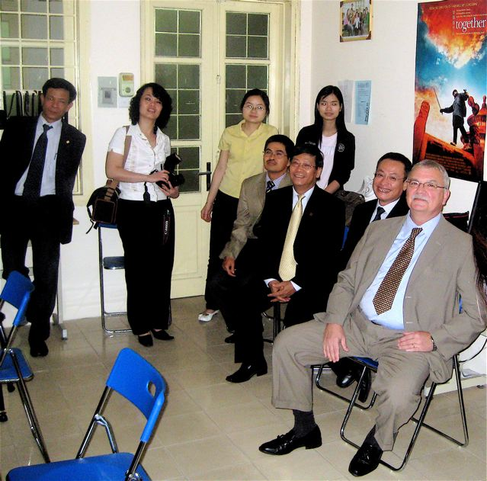
U.S. Ambassador Michael Michalak, HANU President Vang and staff attend special Media Lab screening

Slide 16
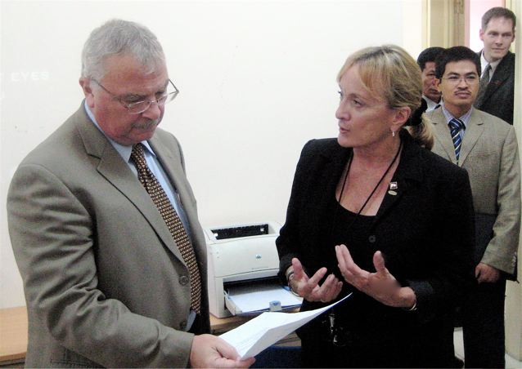
May 2008 – U.S. Ambassador Michael Michalak being briefed on the Media Lab Project

Slide 17
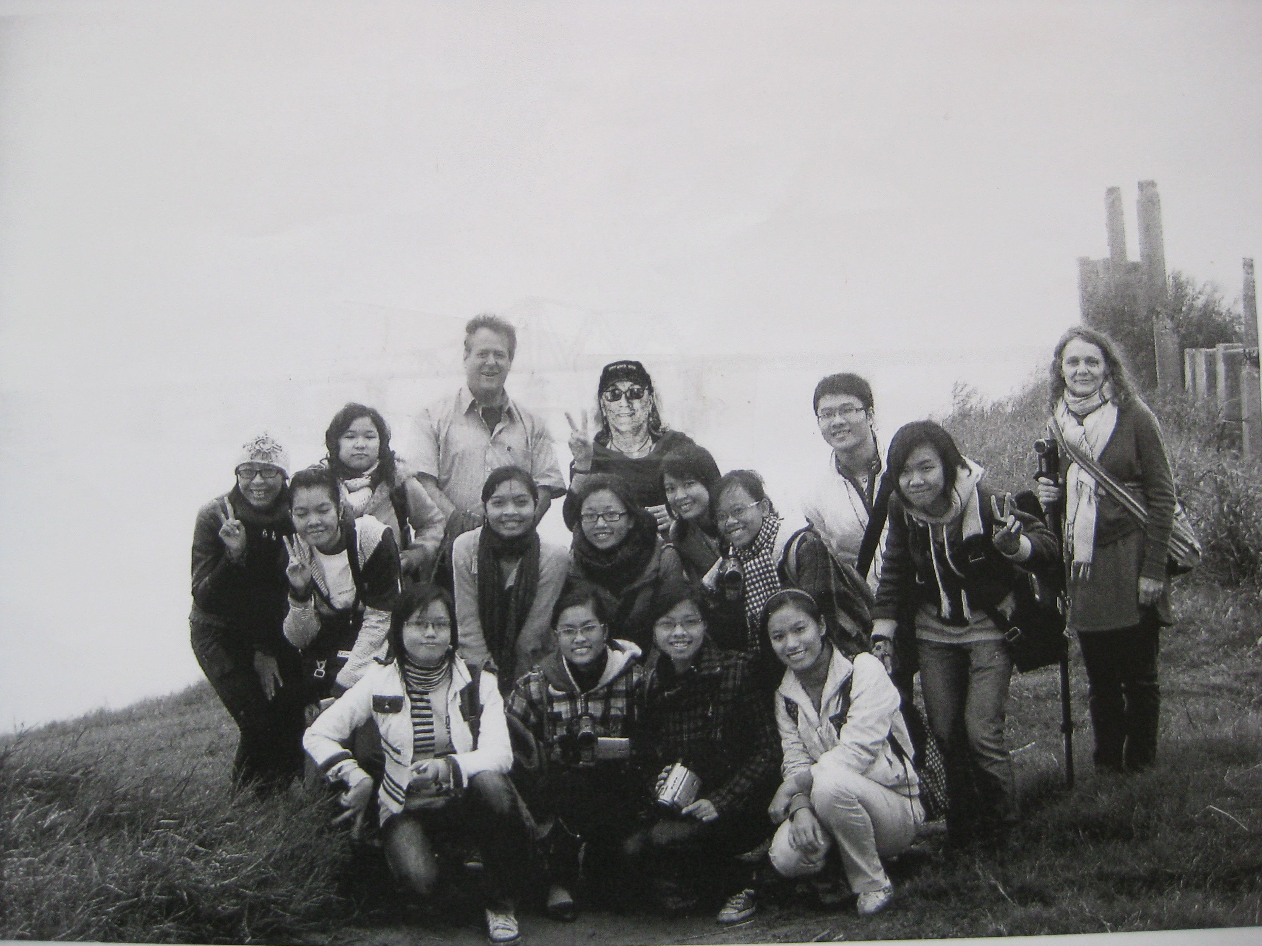
Red River Film Project 2010

Slide 20
Long Bien Story

Slide 21
Floating Futures

Slide 22
Living on Rubbish

Slide 23
Behind the Corn

Slide 24
A Certificate and a USB

Slide 25
Dean Huyen & Professor Jardine

Slide 26
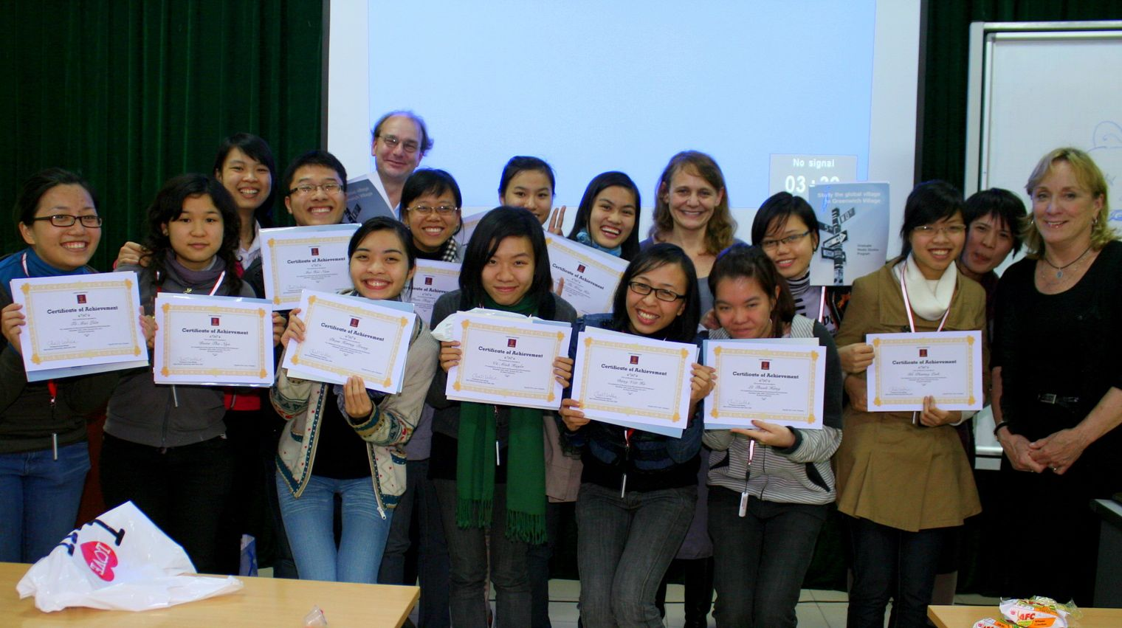
Media Lab Class of January 2010

Slide 27
The Celebrating Begins

Slide 28
Hanoi University Media Lab 2010-11
December 28, 2010 – January 21, 2011
Class Meets Tuesday-Wednesday-Thursday
10 am – 4 pm

